Slide 1
CODALZ
Joshua McDaniel, Xavery Scott, Samantha Jones, Joshua Davis and Matthew dehoFF

Slide 2

What is Codalz?
Codalz is a word game
Each round, a player is given 5 strings of 6 random letters
The player must make as many words as possible from each string
Players can log in, log out, and create a new account
Players can see all previous scores

Slide 3
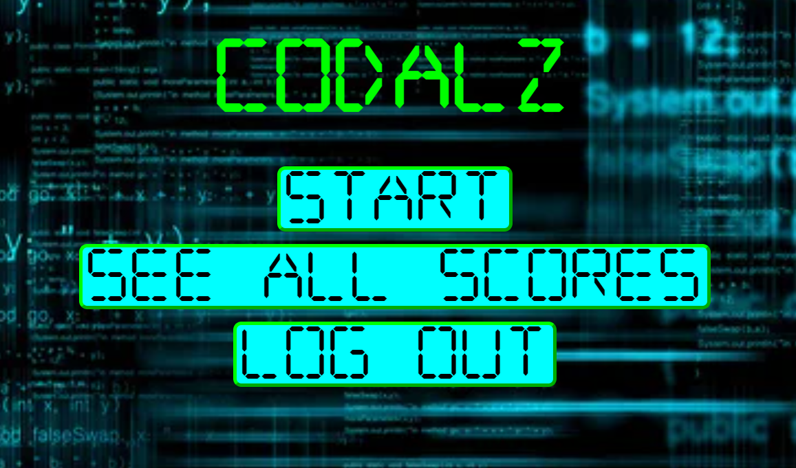

LOGOUT PAGE
HOME PAGE

